Slide 1
UFC Statistics
General Ultimate Fight Championship Analysis
Yuri Almeida Cunha

Slide 2

Agenda
Project Overall
Business Questions
Data Sources
Web Scraping in R
Tableau Dashboards

Slide 3
Project Overall
The UFC dashboard contains all the information related to the Ultimate Fight Championship fights, events and fighters during the period between 12/11/1993 until 10/31/2020. T he user will be able to visualize the detailed information about the decision methods, fighter performances, and many other features.

Slide 4
Business Questions
Event
Date?
State?
Fight
Winner Perfomance?
Fighter
Looser Perfomance?
Gynasium?
Referees?
Total Punches?
Total Strikes?
Total Wins?
Total Looses?
Decision Methods?
Overall Performance?

Slide 5
DataSET
The data sources are a combination between:
UFC historical data on the Kaggle website: https://www.kaggle.com/rajeevw/ufcdata
Web scraped data from the following website: https://www.sherdog.com/

Slide 6
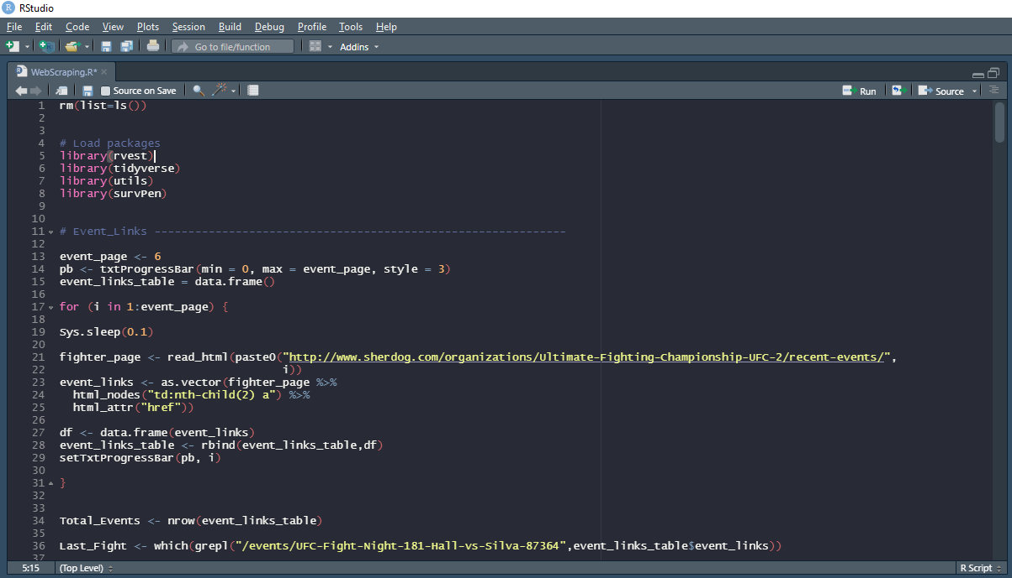



WeB SCRAPING
Click Here

Slide 7
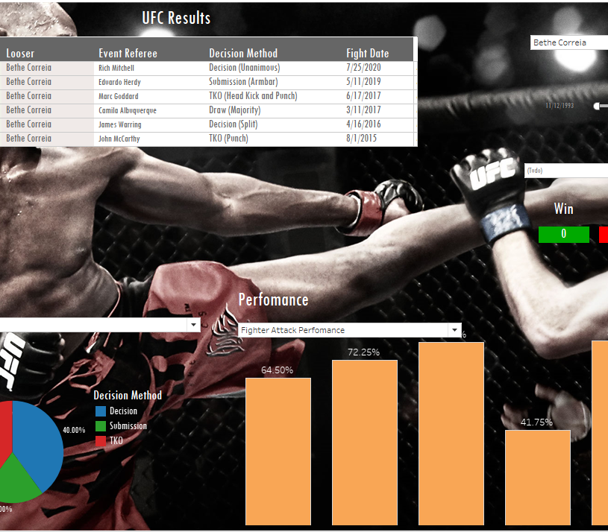
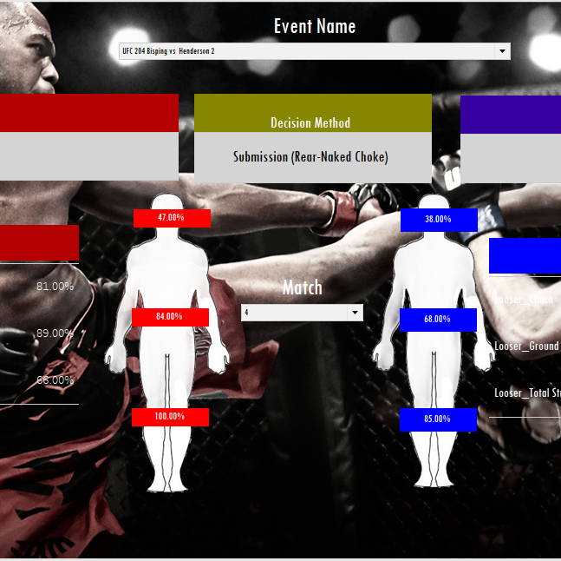
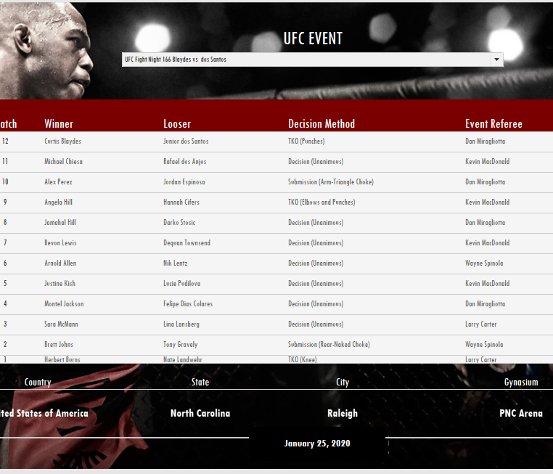

Tableau DashBOARDS
CLICK HERE

Slide 8


Questions

Slide 9
THaNKs!
Phone: +36 20 443 3879
E-mail: yurialmeida5@gmail.com

